Slide 1
DIGITAL LOGIC DESIGN / PROJECT
DESIGN & SIMULATION OF A
DIGITAL DOOR ACCESS
CONTROL SYSTEM
A logic-based approach to secure access
PROJECT TEAM
ACCESS / VERIFY / UNLOCK
2620080034 — Srihitha
2620080017 — Pranathi
2620080018 — Lahari
2620080051 — Nitish
SYSTEM STATUS: READY

Slide 2
DIGITAL LOGIC DESIGN
02
01 / Introduction
▸ Digital access control allows entry only when a user enters the correct code.
▸ The input is represented as binary bits and checked using logic gates.
▸ A valid code activates the unlock signal; an invalid code keeps access denied.
▸ This project demonstrates a basic security concept using combinational logic.
CORE IDEA
INPUT
→ COMPARE
→ DECIDE
Correct code = access granted
Wrong code = access denied
DIGITAL DOOR ACCESS CONTROL / PROJECT PRESENTATION

Slide 3
DIGITAL LOGIC DESIGN
03
02 / Aim & Objectives
AIM
Design and simulate a digital circuit that validates a user-entered access code.
01
02
03
04
INPUT
COMPARE
DECIDE
VERIFY
Accept a 4-bit binary code.
Check each bit against a preset passcode.
Generate UNLOCK or DENIED outputs.
Test correct and incorrect code combinations.
DIGITAL DOOR ACCESS CONTROL / PROJECT PRESENTATION

Slide 4
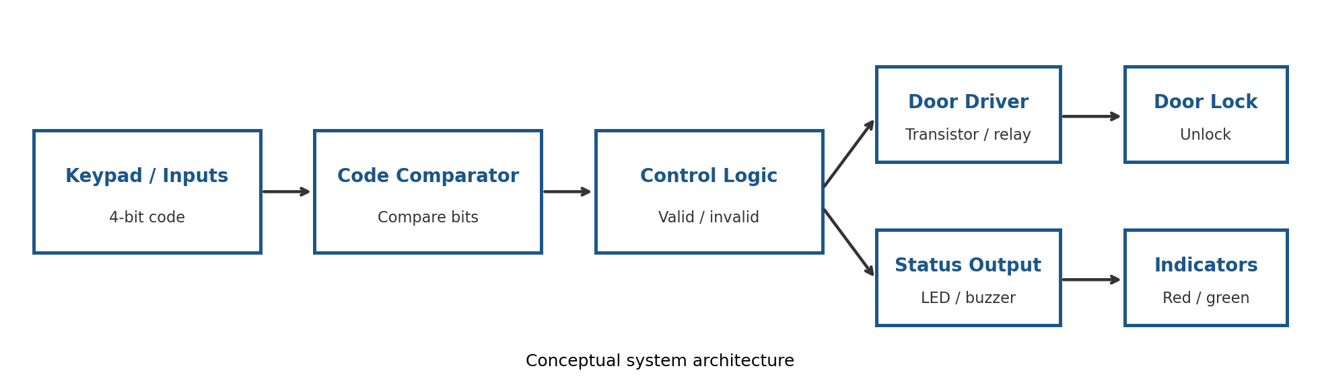
DIGITAL LOGIC DESIGN
04
03 / System Block Diagram
Input → comparator → control decision → door driver and status indicators.
Hardware note: a suitable driver stage is required to operate a physical lock.
DIGITAL DOOR ACCESS CONTROL / PROJECT PRESENTATION

Slide 5
DIGITAL LOGIC DESIGN
05
04 / Components & Functions
INPUT
COMPARE
CONTROL
Switches / keypad
XNOR gates
AND gate
Provide the 4-bit code.
Output 1 when input and stored bits match.
Unlocks only when every bit matches.
INDICATE
DRIVE
POWER
LED / buzzer
Transistor / relay
Regulated supply
Shows granted or denied status.
Interfaces logic with the electronic lock.
Powers logic and lock circuitry.
DIGITAL DOOR ACCESS CONTROL / PROJECT PRESENTATION

Slide 6
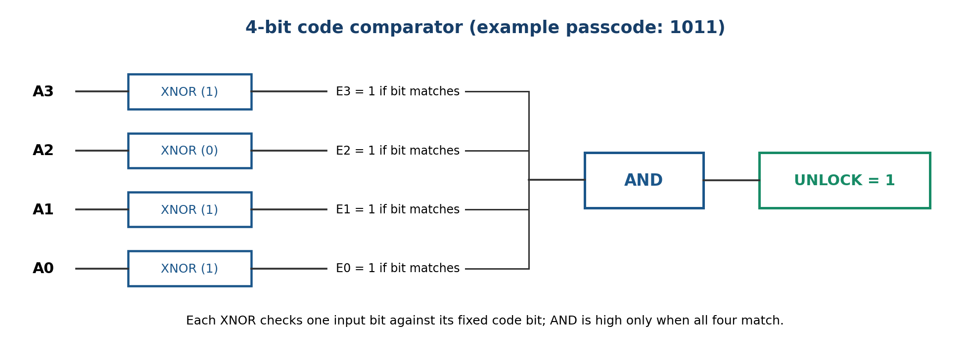
DIGITAL LOGIC DESIGN
06
05 / Circuit Diagram: 4-bit Comparator
EXAMPLE PASSCODE: 1011 | UNLOCK = E3 · E2 · E1 · E0
DIGITAL DOOR ACCESS CONTROL / PROJECT PRESENTATION

Slide 7
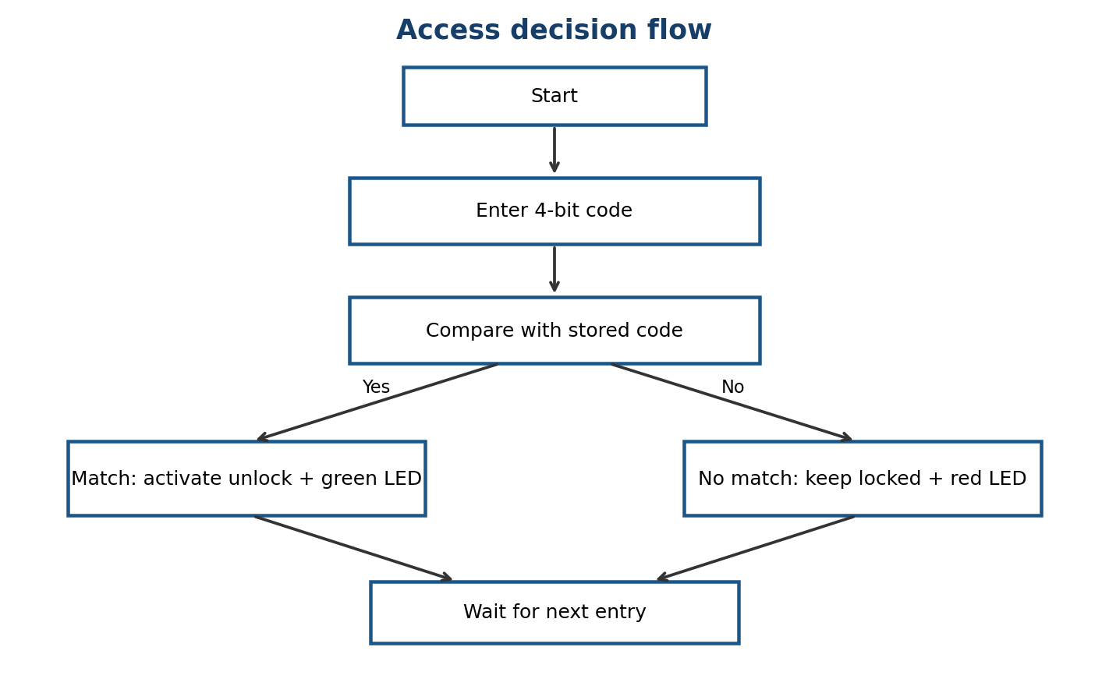
DIGITAL LOGIC DESIGN
07
06 / Working Principle
The system compares all four bits before making an access decision.
DIGITAL DOOR ACCESS CONTROL / PROJECT PRESENTATION

Slide 8
DIGITAL LOGIC DESIGN
08
07 / Simulation & Test Cases
EXPECTED BEHAVIOUR / ONLY 1011 SHOULD UNLOCK
ENTERED CODE | BIT MATCH OUTPUTS | UNLOCK | DECISION
1011 | 1 1 1 1 | 1 | ACCESS GRANTED
1010 | 1 1 1 0 | 0 | ACCESS DENIED
0011 | 0 1 1 1 | 0 | ACCESS DENIED
1111 | 1 0 1 1 | 0 | ACCESS DENIED
SIMULATION CHECK: toggle each input bit and observe the UNLOCK output.
DIGITAL DOOR ACCESS CONTROL / PROJECT PRESENTATION

Slide 9
DIGITAL LOGIC DESIGN
09
08 / Conclusion & Future Improvements
▸ The design demonstrates access control using XNOR and AND gates.
▸ Only code 1011 produces a HIGH unlock signal.
▸ Simulation helps verify logic before hardware implementation.
▸ A fixed 4-bit passcode is a learning example, not real-world security.
NEXT ITERATION
Longer passcode
Keypad encoding
Attempt limit
Alarm / lockout timer
DIGITAL DOOR ACCESS CONTROL / PROJECT PRESENTATION

Slide 10
THANK YOU
SRIHITHA • PRANATHI • LAHARI • NITISH
DIGITAL DOOR ACCESS CONTROL / PROJECT PRESENTATION

